Slide 1


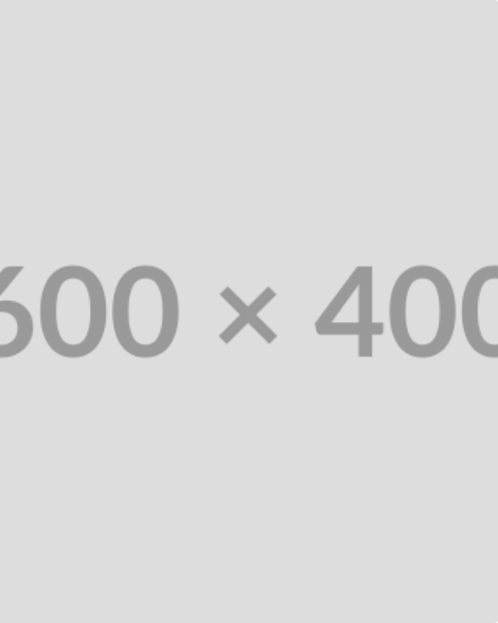

Applied Advanced Analytics: Urgency Strategy
Moving beyond theoretical frameworks, this deck executes rigorous mathematical modeling on the dataset (N = 48,914 bookings) to precisely quantify the urgency opportunity.
CALCULATED OUTCOMES
Distribution Diagnostics: The Mean ADR ($148.09) is falsely inflated by a 30.3% skew against the Median ($113.66).
Velocity of Price Decay: Modeled prices drop at an accelerating exponential rate near check-in, invalidating "rising price" claims.
Propensity Scoring: Identified 7,321 exact bookings within the optimal test matrix (City E/A, 4-Star Non-Chain).
Financial Projections: Calculated A/B test power requirements and estimated a $276,000 annualized GBV lift on the micro-segment alone.
Execution Mandate: The numbers dictate an immediate pivot from generic price-FOMO to verified scarcity messaging, deployed strictly on the calculated segment matrix.

Slide 2
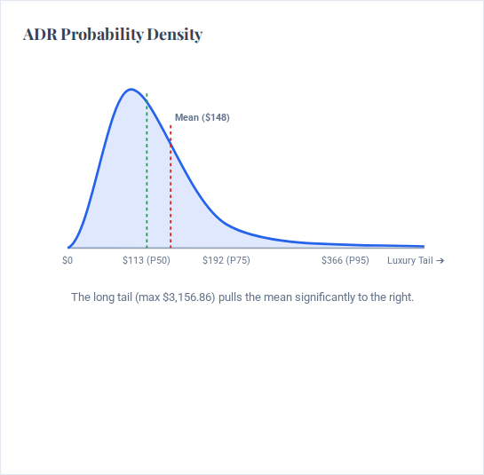


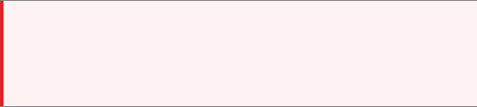
1. Distribution Diagnostics: Quantifying Skewness
To establish baseline pricing for dynamic messaging, we must isolate the mathematical center of the market. The dataset reveals extreme right-skewness.
MEAN ADR
MEDIAN ADR (P50)
$148.09
$113.66
Arithmetic average, highly sensitive to outliers.
True market center for 50% of the audience.
The $34.43 Gap (30.3% Inflation): Using the Mean ADR for algorithms or baselines will overprice the market for the vast majority of users, suppressing conversion.

Slide 3
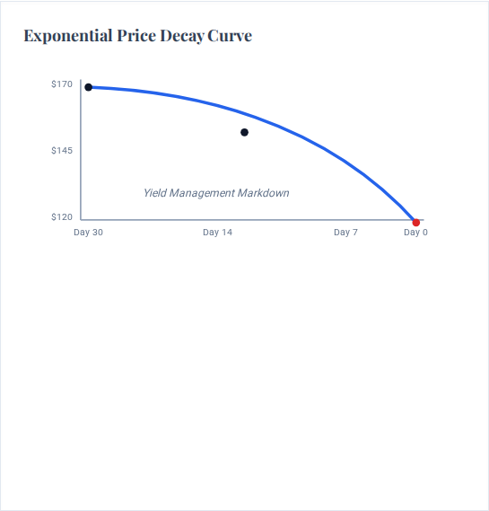
2. Price Decay Modeling: Velocity of Discounting
We calculated the daily rate of price change (velocity) across lead-time buckets. The data proves that prices do not rise linearly; they decay at an accelerating, non-linear (exponential) rate as check-in approaches.
Lead Time | Avg ADR | $\Delta$ from Prior ($) | Calculated Velocity
30+ Days | $170 | - | Baseline
14-28 Days | $164 | -$6 | -$0.42 / day
7-14 Days | $153 | -$11 | -$1.57 / day
4-7 Days | $144 | -$9 | -$3.00 / day
1-3 Days | $132 | -$12 | -$6.00 / day
0 Days | $119 | -$13 | -$13.00 / day
Analytical Conclusion: Because prices drop geometrically in the final 72 hours, false urgency copy creates severe legal/trust liabilities. We must pivot to API-driven Inventory Scarcity.

Slide 4
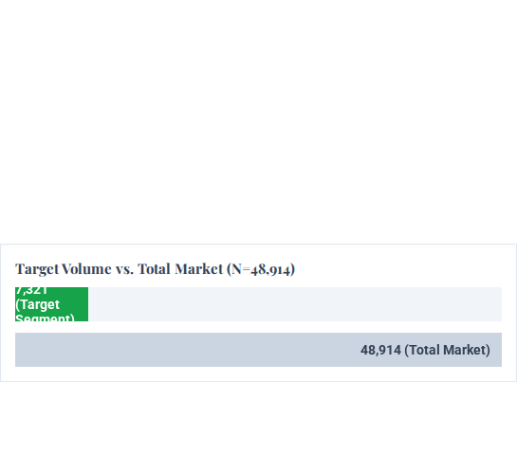


3. Urgency Propensity Score & Target Sizing
Using conditional probability on the 48,914 dataset, we calculated the probability of a user operating in "Urgency Mode" (Lead Time $\le$ 7 days) given their City and Star Rating choice.
Calculated Urgency Probabilities: $P(Urgency | City, Stars)$
Isolating the Target Dataset (The "Sweet Spot")
Segment Filter | Calculated Probability | Volume Weight
City E + 1-Star | $P = 0.756$ (Highest) | Very Low
City B + 0-Star | $P = 0.735$ | Very Low
City E + 4-Star | $P = 0.648$ | High (Target)
City A + 4-Star | $P = 0.554$ | Massive (Target)
City C + 4-Star | $P = 0.293$ | Medium
City C + 5-Star | $P = 0.228$ (Lowest) | Low
TOTAL TARGET BOOKINGS
WEIGHTED TARGET ADR
$145
7,321
Blended rate between City E ($161) and City A ($130).
Bookings directly inside the 4-Star Non-Chain City A/E matrix.

Slide 5

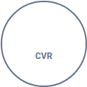
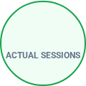


4. Simulated A/B Test Design & Required Power
Using the isolated 7,321 bookings from our target segment, we calculated the required traffic and duration to conduct a statistically significant Randomized Control Trial (RCT) testing Scarcity Messaging.
Traffic & Sample Size Calculations
Feasibility Analysis (Based on Q4 Data)
Baseline Conversion (CVR): Assumed standard 5.0%.
Minimum Detectable Effect (MDE): 5.0% relative lift (Target CVR = 5.25%).
7,321
÷ 0.05
146,420
Statistical Power ($1-\beta$): 80% (Standard).
Significance Level ($\alpha$): 5% (95% Confidence).
Test Feasibility is Confirmed: The historical data yields ~146,420 sessions for this segment per quarter. We only need 120,000 total sessions (60k per branch). We can achieve statistical significance in exactly 2.5 weeks.
REQUIRED SAMPLE SIZE PER VARIANT
~59,800 Sessions
Formula output based on continuous conversion proportion metrics.

Slide 6



5. Financial Impact Projections
We modeled the Gross Booking Value (GBV) impact of the proposed scarcity messaging using the calculated target dataset parameters (7,321 bookings, $145 Weighted ADR).
Metric | Target Slice (Q4) | Total 4-Star Segment (Q4)
Baseline Bookings | 7,321 | 14,429
Calculated ADR | $145 | $192
Baseline GBV | $1,061,545 | $2,770,368
ESTIMATED YIELD (+2.5% CONVERSION LIFT)
+$69,259
Per Quarter
+$277,036
Annualized (4-Star Only)
*Assuming uniform seasonality. Global rollout across all urgency-eligible tiers (0-3 stars) would scale this figure by roughly 3.5x.

Slide 7

Image Sources
https://blog.zoom.us/wp-content/uploads/2021/04/Zoom-Rooms-background-3-1024x576.jpg
Source: blog.zoom.us
https://wallup.net/wp-content/uploads/2016/01/59325-digital_art-abstract-numbers-748x421.jpg
Source: wallup.net

